Slide 1
Unit-1

Slide 2
Analog vs Digital
Analog signal are time varying
Analog devices accepts value across a continuous range
Digital signal is modeled as accepting only one of two discrete value. High ‘1’ or Low ‘0’
Digital devices preferred over Analog
Reproducibility of result
Ease of design
Flexibility
Programmability
Processing speed
Economy
Steadily advanced technology
Most common digital devices are Logic gate, Flip Flop

Slide 3
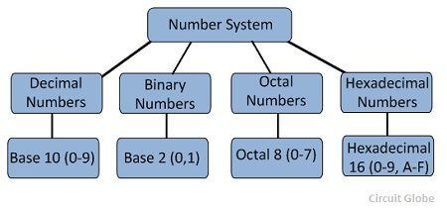
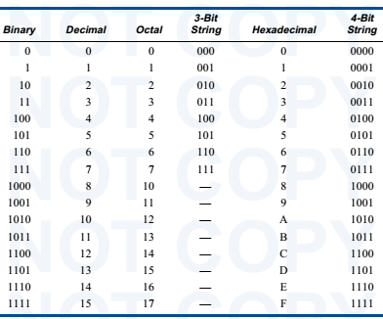
Number System and Code
Digital system process binary digits 0 and 1
Base 10 is important for everyday business
Base 2 is important for processing of digital circuit
Base 8 and Base 16 provide convenient shortened representation for multibit number in a digital system

Slide 4
Positional Number System
Digital system can understand positional number system
Value of a number is determined with help of digit, position of the digit in the number and base of the number system
Decimal positional number
Each weight is a power of 10.
Decimal point allow negative as well as positive power of 10
In general a Number D in base r

Slide 5
Base-10 Placeholders
Number Systems(continued)
4
3
6
Number:
Placeholder Name:
“Tens”
“Ones”
“Hundreds”
Value:
100*4
10*3
1*6
Exponential Expression:
10²*4
10¹*3
10⁰*6

Slide 6
Base-2 Placeholders
Number Systems(continued)
1
0
1
Number:
Placeholder Name:
“Fours”
“Twos”
“Ones”
n₁₀ Value:
4*1
2*0
1*1
2⁰*1
n₁₀ Exponential Expression:
2²*1
2¹*0

Slide 7
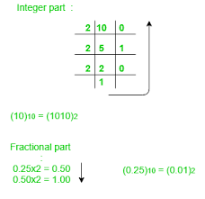
Number conversion
Methods or techniques used to convert numbers from one base to another
Decimal to Other
Step 1 − Divide the decimal number to be converted by the value of the other base.
Step 2 − Get the remainder from Step 1 as (least significant digit) of new base number
Step 3 − Divide the quotient of the previous divide by the new base.
Step 4 − Record the remainder from Step 3 as the next digit
Repeat Steps 3 and 4, getting remainders until the quotient becomes zero
The last remainder thus obtained will be the Most Significant bit(MSB) of the new base number.

Slide 8
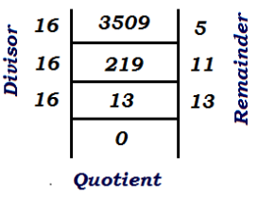
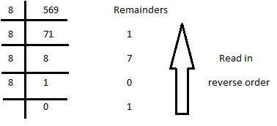
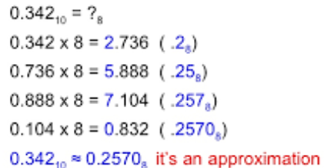

Slide 9
Converting Base-10 to Base-2
Number Systems(continued)
STEP SIX: The resulting 1s and 0s in the top row form the binary equivalent of the Base-10 number with which we started:
21₁₀ = 10101₂

Slide 10
The octal equivalent of the decimal number (417)10 is _____ a) (641)8 b) (619)8 c) (640)8 d) (598)8

Slide 11
Answer: a
Octal equivalent of decimal number is obtained by dividing the number by 8 and collecting the remainders in reverse order. 8 | 417 8 | 52 — 1 8 | 6 – 4 So, (417)10 = (641)8.

Slide 12
(170)10 is equivalent to ____________ a) (FD)16 b) (DF)16 c) (AA)16 d) (AF)16

Slide 13
Answer: c Explanation: Hexadecimal equivalent of decimal number is obtained by dividing the number by 16 and collecting the remainders in reverse order. 16 | 170 16 | 10 – 10 Hence, (170)10 = (AA)16.

Slide 14
Convert (0.345)10 into an octal number. a) (0.16050)8 b) (0.26050)8 c) (0.19450)8 d) (0.24040)8

Slide 15
Answer: b Explanation: Converting decimal fraction into octal number is achieved by multiplying the fraction part by 8 everytime and collecting the integer part of the result, unless the result is 1. 0.345*8 = 2.76 2 0.760*8 = 6.08 6 00.08*8 = 0.64 0 0.640*8 = 5.12 5 0.120*8 = 0.96 0 So, (0.345)10 = (0.26050)8

Slide 16
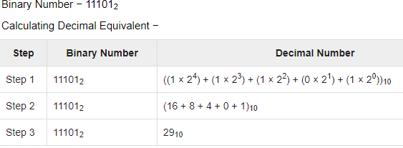
Other Base System to Decimal System
Step 1 − Determine positional value of each digit
Step 2 − Multiply the obtained position values by the digits in the corresponding columns.
Step 3 − Sum the products calculated in Step 2.
32 16 8 4 2 1
1 0 0 1 1 1 =32 + 4 +2 +1 = (39)10

Slide 17
Converting Base-2 to Base-10
Number Systems(continued)
1
0
0
1
1₂
ON/OFF
ON
OFF
OFF
ON
ON
Exponent:
2⁴
2³
2²
2¹
2⁰
16
0
0
2
1
Calculation:
+
+
+
+
=
19₁₀

Slide 18
Converting Base-8 to Base-10
Number Systems(continued)
2374₈
STEP ONE: Multiply each octal digit by the exponential expression that represents its placeholder:
2 * 8³
=
1024
3 * 8²
=
192
7 * 8¹
=
56
4 * 8⁰
=
4

Slide 19
Converting Base-8 to Base-10
Number Systems(continued)
2374₈
=
1276₁₀
STEP TWO: Add the products together. The sum represents the Base-10 equivalent:
1024 + 192 + 56 + 4 = 1276

Slide 20
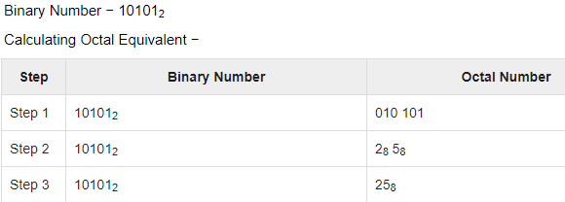
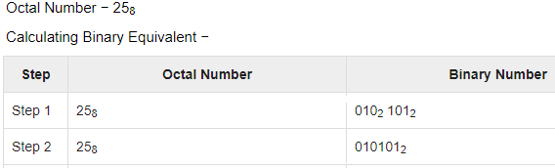
Binary to Octal
Step 1 − Divide the binary digits into groups of three (starting from the right).
Step 2 − Convert each group of three binary digits to one octal digit.
Octal to Binary
Step 1 − Convert each octal digit to a 3 digit binary number.
Step 2 − Combine all the resulting binary groups (of 3 digits each) into a single binary number

Slide 21
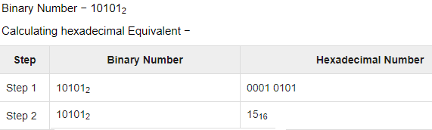
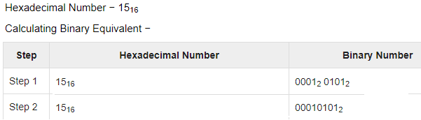
Binary to Hexadecimal
Step 1 − Divide the binary digits into groups of four (starting from the right).
Step 2 − Convert each group of four binary digits to one hexadecimal symbol.
Hexadecimal to Binary
Step 1 − Convert each hexadecimal digit to a 4 digit binary number.
Step 2 − Combine all the resulting binary groups (4 digits each) into a single binary number.

Slide 22
Convert (214)8 into decimal. a) (140)10 b) (141)10 c) (142)10 d) (130)10

Slide 23
Answer: a Explanation: Octal to Decimal conversion is obtained by multiplying 8 to the power of base index along with the value at that index position. (214)8 = 2 * 8v + 1 * 8¹ + 4 * 8⁰ = 128 + 8 + 4 = (140)10.

Slide 24
Convert the hexadecimal number (1E2)16 to decimal. a) 480 b) 483 c) 482 d) 484

Slide 25
Answer: c Explanation: Hexadecimal to Decimal conversion is obtained by multiplying 16 to the power of base index along with the value at that index position. (1E2)16 = 1 * 16² + 14 * 16¹ + 2 * 16⁰ (Since, E = 14) = 256 + 224 + 2 = (482)10.

Slide 26
The given hexadecimal number (1E.53)16 is equivalent to ____________ a) (35.684)8 b) (36.246)8 c) (34.340)8 d) (35.599)8

Slide 27
Answer: b Explanation: First, the hexadecimal number is converted to it’s equivalent binary form, by writing the binary equivalent of each digit in form of 4 bits. Then, the binary equivalent bits are grouped in terms of 3 bits and then for each of the 3-bits, the respective digit is written. Thus, the octal equivalent is obtained. (1E.53)16 = (0001 1110.0101 0011)2 = (00011110.01010011)2 = (011110.010100110)2 = (011 110.010 100 110)2 = (36.246)8.

Slide 28
The octal number (651.124)8 is equivalent to ______ a) (1A9.2A)16 b) (1B0.10)16 c) (1A8.A3)16 d) (1B0.B0)16

Slide 29
Answer: a Explanation: First, the octal number is converted to it’s equivalent binary form, by writing the binary equivalent of each digit in form of 3 bits. Then, the binary equivalent bits are grouped in terms of 4 bits and then for each of the 4-bits, the respective digit is written. Thus, the hexadecimal equivalent is obtained. (651.124)8 = (110 101 001.001 010 100)2 = (110101001.001010100)2 = (0001 1010 1001.0010 1010)2 = (1A9.2A)16.

Slide 30
Practice Question

Slide 31
Practice Question

Slide 32
Practice Question

Slide 33
Practice Question

Slide 35
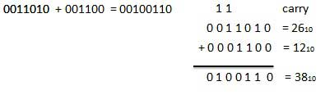
Binary Addition
0 + 0 = 0 0 + 1 = 1 1 + 0 = 1 1 + 1 = 10 (which is 0 carry 1)

Slide 36
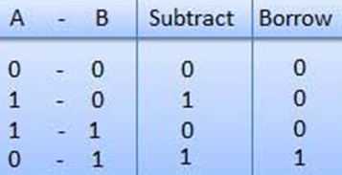
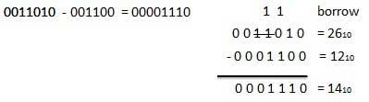
Binary Subtraction

Slide 37
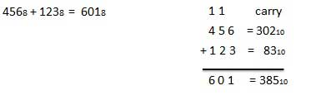
Octal Addition
eight digits, 0,1,2,3,4,5,6,7
After 7 10, 11…….
0
1
2
3
4
5
6
7
Count in forward direction (0-7)
After each cycle update carry 1

Slide 38
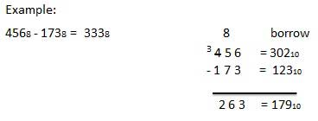
Octal Subtraction
0
1
2
3
4
5
6
7
Count in backward direction (7-0)
After each cycle update carry - 1

Slide 39
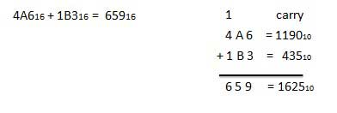

Hexadecimal Addition
0
1
2
3
4
5
6
7
8
9
A
B
C
D
E
F
10 digits and 6 letters, 0,1,2,3,4,5,6,7,8,9,A,B,C,D,E,F.
A = 10, B = 11, C = 12, D = 13, E = 14, F = 15.
After F 10,11…….
Count in forward direction (0-F)
After each cycle update carry 1

Slide 40
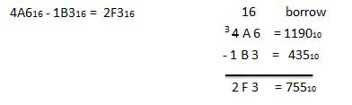
Hexadecimal Subtraction
0
1
2
3
4
5
6
7
8
9
A
B
C
D
E
F
Count in backward direction (7-0)
After each cycle update carry - 1

Slide 41
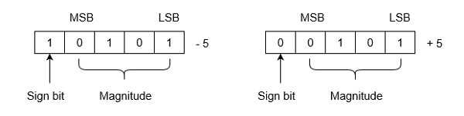
Negative Number Representation Sign Magnitude r’s Compliment (r-1)’s Compliment
Sign magnitude Representation: Number consist of magnitude (lower number) and sign bit (MSB)
MSB 0 Positive Number
MSB 1 Negative Number

Slide 42
Compliment
Sign magnitude negate a number by sign
Compliment system negate number by taking its compliment
Radix Compliment |  | Diminished Radix Compliment
r’s compliment |  | (r-1)’s compliment
Binary | 2’s | 1’s
Octal | 8’s | 7’s
Decimal | 10’s | 9’s
Hexadecimal | 16’s | 15’s
Base 6 | 6’s | 5’s

Slide 43
Radix (r) compliment
($r−1) compliment of N=(r^{n}−1)−N$ where r is base n is number of digit
R compliment of N $=r^{n}−N$
= (r – 1) compliment +1

Slide 44
Compliment Continue
-> 1’s compliment can obtain by replacing 0 by 1 and 1 by 0
-> 2’s compliment can obtain by replacing 1 by 0 and 0 by 1 after 1st high bit from LSB
->complement of the complement restores the number to its original value.
2’s complement of binary number 10101110.
Method-1
obtain (1’s compliment of 10101110) + 1
01010001 + 1
2’s compliment is 01010010
2’s complement of binary number 10101110.
Method-2
First high bit from LSB at 1st position
after that obtain 1’s compliment
2’s compliment is 01010010

Slide 45
Practice Question

Slide 46
Signed Number representation
Signed-Complement – a negative number is represented by its complement.
First represent the number with positive sign and then take complement of that number.

Slide 47
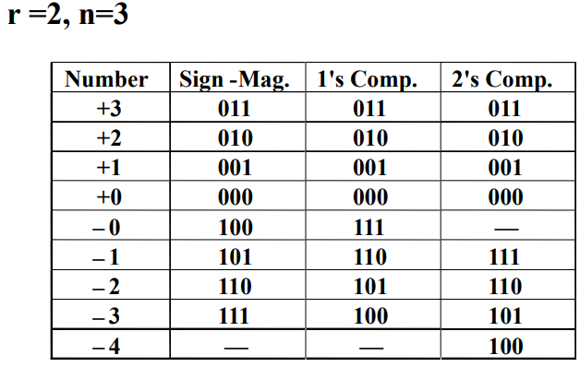
Signed Number representation
Signed-Magnitude – consists of a magnitude and a symbol (0 for +, 1 for -)
Range of signed magnitude is
1’s Compliment
Range
Limitation is positive and negative zero
2’s Compliment
Range
Limitation is positive and negative zero

Slide 48
The 2's complement representation of the decimal value -15 is
(a) 1111 (b) 11111 (c) 111111 (d) 10001
sign magnetuide
-15 = 1 1111
2’s compliment 1 0001
2’s Compliment representation of 16-bit number is FFFF, its magnitude in decimal is
Let 2’s compliment of X is 1111_1111_1111_1111
X= 2’s of 1111_1111_1111_1111
0000_0000_0000_0001
2’s compliment representation of -17 in decimal is
+17= 10001
-17 in 2’s compliment 01111

Slide 49
Subtraction by Addition of r’s Compliment
Subtraction can carried by means of addition of complimented number.
Add minuend M to the compliment of subtrahend N
M-N = M + r’s compliment of N
If M ≥ N sum will produce end carry which is discarded -> positive result
If M ≤ N sum will not produce end carry to obtain result take r’s compliment of sum again -> Negative result
Using 10’s compliment 72532 – 03250
9’s compliment of 3250 = 99999 – 03250 = 96749
10’s compliment of 3250 = 96479 + 1 = 96750
72532 + 10’s compliment of 3250 = 72532 + 96750
= 169282
End carry exits positive result
Discard the carry final result = 69282
Using 10’s compliment 3250 - 72532
9’s compliment of 72532 = 99999 – 72532 = 27468
10’s compliment of 72532 = 27468 + 1 = 27469
3250 + 10’s compliment of 72532 = 03250 + 27469
= 30718
No end carry result in negative
Take 10’s compliment of 30718
9’s compliment of 30718= 99999 – 30718 = 69281
10’s compliment of 30718 = 69281 + 1 = 69282
Final result -69282

Slide 50
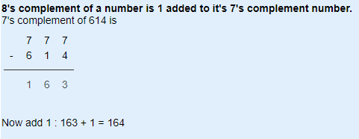
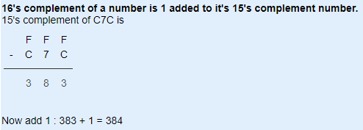


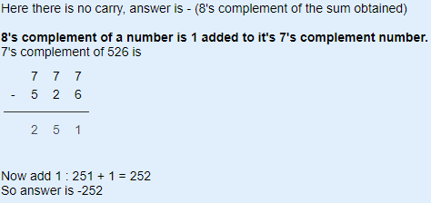
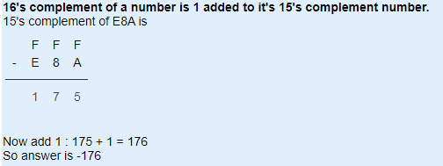
Subtraction by Addition of Compliment
Find Subtraction of 342 and 614 using 8's complement method
Find Subtraction of B06 and C7C using 16's complement method

Slide 51
Perform 1010100 – 1000011 using 2’s compliment
2’s compliment of 1000011 is 0111101
Perform 1000011 - 1010100 using 2’s compliment
2’s compliment of 1010100 is 0101100

Slide 52
Subtraction by Addition of (r-1)’s Compliment
Subtraction can carried by means of addition of complimented number.
Add minuend M to the compliment of subtrahend N
M-N = M + (r-1)’s compliment of N
If M ≥ N sum will produce end carry which is added in result -> positive result
If M ≤ N sum will not produce end carry to obtain result take (r-1)’s compliment of sum again -> Negative result
Perform 1010100 – 1000011 using 1’s compliment
1’s compliment of 1000011 is 0111100
Perform 1000011 - 1010100 using 1’s compliment
1’s compliment of 1010100 is 0101011

Slide 53
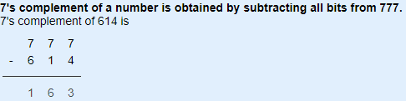
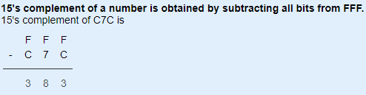


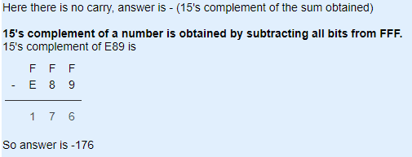
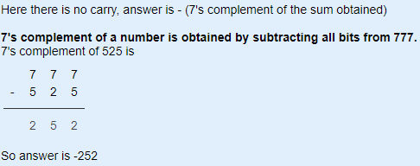
Subtraction by Addition of Compliment
Find Subtraction of 342 and 614 using 7's complement method
Find Subtraction of B06 and C7C using 15's complement method

Slide 54
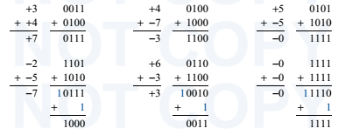
Practice Question
Addition is performed with 1’s compliment representation of signed number

Slide 55
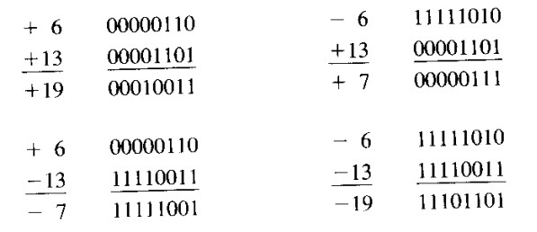
Practice Question
Addition is performed with 2’s compliment representation of signed number
Carry our of the sign bit is discarded and negative result automatically stores in 2’s compliment format

Slide 56
Binary code for Decimal number
Binary code are appropriate for internal computation of a digital system
People prefer to deal with decimal number
External interface of a digital system accepts/process/displays decimal number directly
Binary code for decimal digit requires minimum four bits.
Different code can obtain by arranging four or more bit
Binary Code
Weighted Code
Non Weighted Code
each position of the number represents a specific weight
Binary Code, Octal Code, Decimal Code, Hexadecimal code,
Binary Coded Decimal (BCD) Code
each position within the binary number is not assigned a fixed value
Excess3 code, Gray code

Slide 57
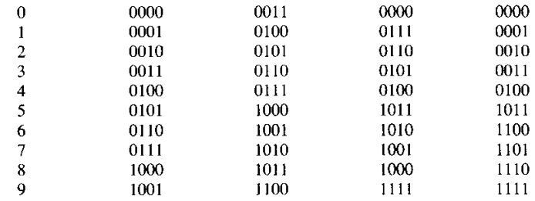
Set of n-bit string represent a number called code
A particular combination of n-bit value is codeword
BCD (Binary coded Decimal) is straight assignment of binary equivalent
BCD code ranges from 0-9
Excess-3 code is self complimentary code
Decimal Digit | BCD Code 8 4 2 1 | Excess-3 | 8 4 -2 -1 | 2 4 2 1

Slide 58
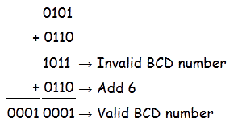
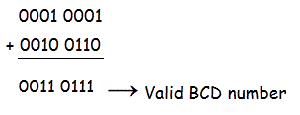
BCD Addition
BCD the binary number formed by four bit 0000-1001
Each digit represented by separate 4 bit
BCD addition similar to binary addition - addition of two binary number is greater than 9,not valid for BCD number
Add 6 whose binary equivalent is (0110)₂ to the result of addition.

Slide 59
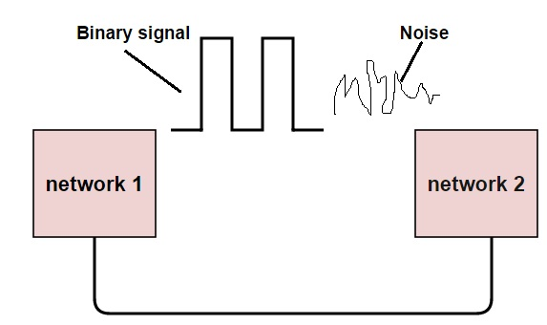
Error Detection Code
Error in digital system is the corruption of data due to external noise
Failure may be temporary or permanent
If 1 is changed to zero or 0 is changed to 1, it is called “Bit error”
errors are transferred from one communication system to another, along with the data.
If these errors are not detected and corrected, data will be lost
Types of Error detection
Parity Checking
Cyclic Redundancy Check (CRC)
Longitudinal Redundancy Check (LRC)
Check Sum

Slide 60
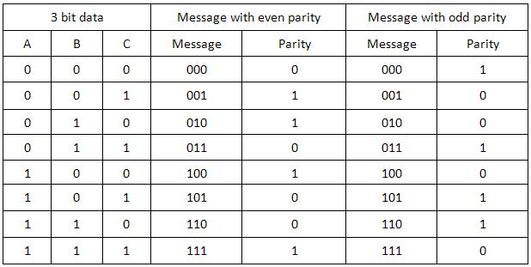
Parity Bit
Parity bit (P) is an extra bit included in the message to make the total number of 1 either even or odd
If ODD parity chosen P is such that total number of bit is odd
If EVEN parity chosen P is such that total number of bit is even
Parity bit generated during transmission end and send along with message
At destination parity of received message is check
If parity at received end is not same as transmission end implies at least one bit changed (bit error occurs)

Slide 61

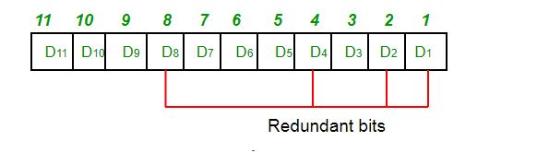
Hamming Code
Hamming code is a set of error-correction codes that can be used to detect and correct the errors
Redundant bits are extra binary bits that are generated and added
If data bits is 7, then the number of redundant bits can be calculated using = 2^4 ≥ 7 + 4 + 1, redundant bits= 4
Hamming Code uses the extra parity bits to allow the identification of an error.
Write the bit positions starting from 1
All the bit positions that are a power of 2 are marked as parity bits (1, 2, 4, 8, etc)
All the other bit positions are marked as data bits
Each data bit is included in a unique set of parity bits, as determined its bit position in binary form

Slide 62
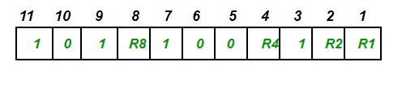




Hamming code example
Data to be transmitted is 1011001
The number of data bits = 7
The number of redundant bits = 4
The total number of bits = 11
The redundant bits are placed at positions corresponding to power of 2➔1, 2, 4, and 8
Determining the Parity bits for Even Parity
R1 bit is calculated using parity check at all the bits positions whose binary representation includes a 1 in the least significant position.R1: bits 1, 3, 5, 7, 9, 11
For even parity R1=0
R4 bit is calculated using parity check at all the bits positions whose binary representation includes a 1 in the third significant position.R4: bits 4, 5, 6, 7
For even parity R4=1
R2 bit is calculated using parity check at all the bits positions whose binary representation includes a 1 in the second position from the least significant bit.R2: bits 2,3,6,7,10,11
For even parity R2=1
R5 bit is calculated using parity check at all the bits positions whose binary representation includes a 1 in the fourth position from the least significant bit.R2: bits 8, 9, 10, 11
For even parity R8=0

Slide 63
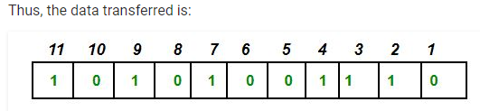
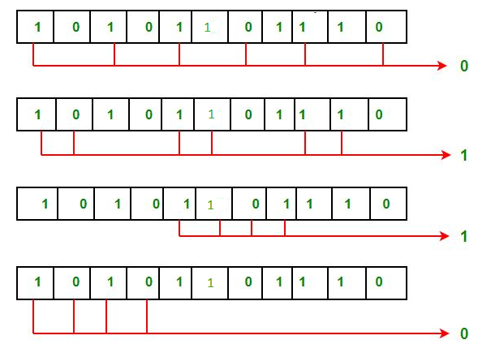
Error detection and correction
If 6th bit is changed from 0 to 1 during data transmission
Find parity bit (R1,R2,R4 and R8) again (with their position dcussed in last slide)
Gives new parity values in the binary number 0110, implied error detected on 6th bit

